Slide 1
Severe Winter Storms Disaster Declaration Update February and March 2015
March 24, 2015

Slide 2
Requested for PDAs - February Adair Barren Bath Boyle Bullitt Clark Cumberland Edmonson Elliott Estill Floyd Green Harrison Hart Jessamine Knott Knox Lawrence Lee Letcher Lincoln Madison Magoffin Menifee Metcalfe Montgomery Morgan Perry Pike Powell Rockcastle Simpson Trigg Washington Wolfe

Slide 3
Need More Damage Data - February Allen * Anderson * Bourbon * Butler * Clay Fayette Garrard * Grayson * Hardin Jackson * Jefferson * Johnson Logan* Marion * Martin * Mercer * Nelson * Ohio * Pulaski * Russell * Scott * Taylor * Warren Whitley
* No data received from county
** Waiting for KYTC data

Slide 4
Requested for PDAs - March Boyd Breathitt Carter Elliott Estill Fleming Floyd Grant Greenup Hancock Hart Johnson Knott Lawrence Lee Leslie Letcher Lewis Magoffin Martin Morgan Owen Pendleton Perry Pike Rowan Trigg Woodford

Slide 5
Anderson * Bourbon ** Boyle* Breckinridge * Bullitt* ** Butler* ** Calloway * ** Christian* ** Daviess* ** Fayette ** Franklin* ** Gallatin Graves* ** Grayson * Hardin Harrison Henry * ** Hopkins ** Jefferson * ** Jessamine ** Larue * Marion * Marshall ** Mason* McCracken ** Meade* Mercer * ** Muhlenberg* ** Nelson * Ohio * ** Oldham ** Robertson ** Scott * ** Shelby ** Spencer* ** Taylor *
Need More Damage Data - March
* No data received from county
** Waiting on KYTC data

Slide 6
- You and all eligible applicants in your county MUST complete: KYEM 501 Damage Assessment Form - Show all damage to infrastructure by: amounts category location - Submit forms to KYEM Area Office

Slide 7
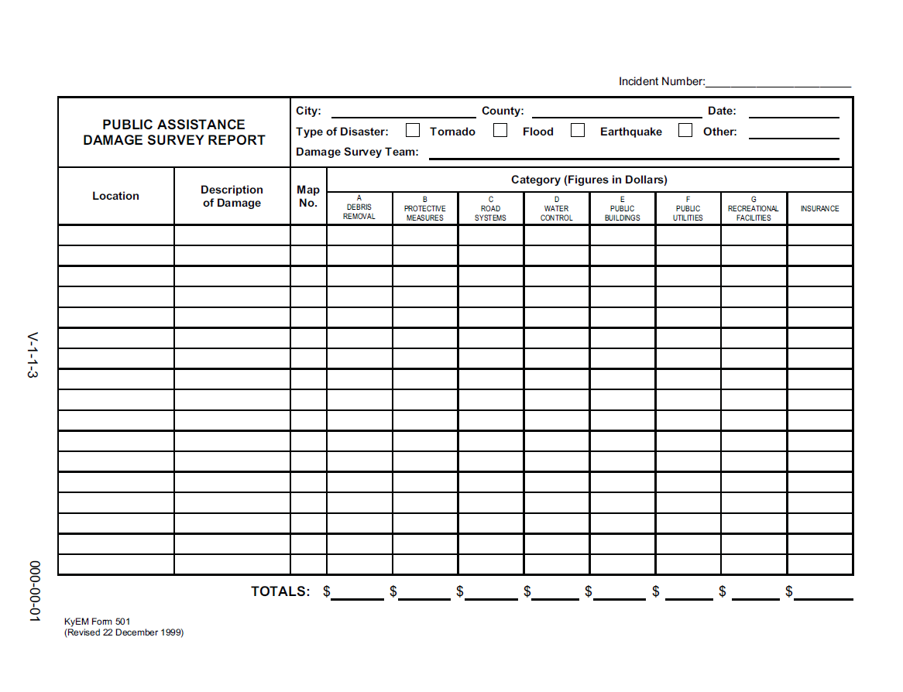
KYEM Form 501

Slide 8
Joint Damage Assessments Begin March 30 Be Prepared - Identify a meeting location for the team - Have transportation available - Have your records ready for review - Provide photos, maps, news articles

Slide 9
Be Prepared - map all damage sites - list all damage sites and types of damages - timesheets, salary and benefit rates - plow/salting route assignments, logs - equipment logs - material logs, costs - contracts, invoices, bills - insurance policies - volunteer efforts - pre-identify any environmental concerns

Slide 10
Have the right people on your assessment team - Road Foreman - Treasurer, Payroll Clerk - Representatives from other reporting entities such as cities, water districts, etc. Review all records and include any and all expenses not previously reported Show FEMA everything - visit all damage sites

